Slide 1
Report On Phishing Domain Dectection

Slide 2
Objective
Identify and prevent malicious activities: The primary objective of phishing domain detection is to identify and block malicious activities aimed at theft of sensitive information, such as login credentials, financial data, and personal information.
Protect brand reputation: Phishing attacks can significantly damage the reputation of a company or organization. The objective of phishing domain detection is to prevent such attacks and safeguard the brand's image and trustworthiness.

Slide 3
Benefits
Early detection and prevention: Implementing phishing domain detection helps in identifying phishing websites and domains in the early stages, thereby preventing potential threats before they can cause significant harm.
Reduction in financial losses: By preventing users from falling victim to phishing attacks, organizations can avoid financial losses associated with identity theft, fraud, and legal consequences.
Protection of sensitive data: Phishing domain detection helps in safeguarding sensitive information, including employee and customer data, leading to enhanced data security and privacy.
Enhanced customer trust: By actively detecting and preventing phishing attacks, organizations can demonstrate their commitment to protecting their customers, thereby enhancing trust and loyalty.
Regulatory compliance: Implementing robust phishing domain detection measures can help organizations remain compliant with industry regulations and data protection laws.

Slide 4
Architecture
Database (Kaggle)
Data Collection
Exploratory Data Analysis (EDA)
Feature Engineering
Feature Selection
Model Creation
Model Performance
Model Saving
User Interface Designing
Flask API Development
User Data Validation
Cloud Setup
Model Deployment

Slide 5
Data Sharing Agreement
While I don’t have specific information on data sharing agreements, it’s important to note that any data used for backorder prediction should be shared in compliance with all relevant data privacy laws and regulations.

Slide 6
Data Validation and Transformation
Data validation ensures that the data used for prediction is accurate, relevant, and formatted correctly. Transformation processes might include normalization, handling missing values, and encoding categorical variables

Slide 7
Model Training
The model is trained using historical data from inventories, supply chain, and sales¹. Various machine learning models like Distributed Random Forest (DRF) and Gradient Boosting Machine (GBM) have been used for this purpose³.

Slide 8
Model Selection
The model that provides the best performance on a validation set is selected. Performance can be measured using various metrics such as accuracy, precision, recall, F1 score, or area under the ROC curve¹.

Slide 9
Prediction
The selected model is used to predict whether a product will go on backorder based on different factors available in the dataset¹.

Slide 10
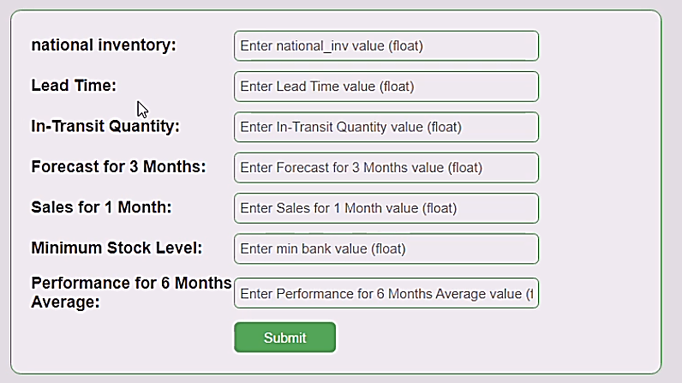
Interface

Slide 11
Questions and Answers
Q1) What’s the source of data?
The data for training is provided by the client in multiple batches and each batch contain multiple files
Q 2) What was the type of data?
The data was the combination of numerical values.
Q 3) What’s the compleate flow you followed in this Project?
Refer slide 5th for better Understanding
Q 4) After the File validation what you do with incompatible file or files which didn’t pass the validation?
Files like these are moved to the Achieve Folder and a list of these files has been shared with the client and we removed the bad data folder.

Slide 12
Questions and Answers
Q 5) How logs are managed?
We are using different logs as per the steps that we follow in validation and
modeling like File validation log , Data Insertion ,Model Training log , prediction log
etc.
Q 6) What techniques were you using for data pre-processing?
Removing unwanted attributes Visualizing relation of independent variables with each other and output variables Checking and changing Distribution of continuous values Removing outliers Cleaning data and imputing if null values are present.Scaling the data

Slide 13
Questions and Answers
Q 7) How training was done or what models were used?
Before diving the data in training and validation set we performed clustering over fit to divide the data into clusters.
As per cluster the training and validation data were divided.
The scaling was performed over training and validation data Algorithms like SVM were used based on the recall final model was used for each cluster and we saved that model .
Q 8) How Prediction was done?
The testing files are shared by the client .We Perform the same life cycle till the data is clustered .Then on the basis of cluster number model is loaded and perform prediction. In the end we get the accumulated data of predictions.

Slide 14
Questions and Answers
Q 9) What are the different stages of deployment?
When the model is ready we deploy it in Fire environment .Where SIT and UAT is performed over it.
Once We get Sign off from Fire we deploy in Earth and UAT is performed over it.
After getting the sign off from Earth we deploy in production

